Slide 1
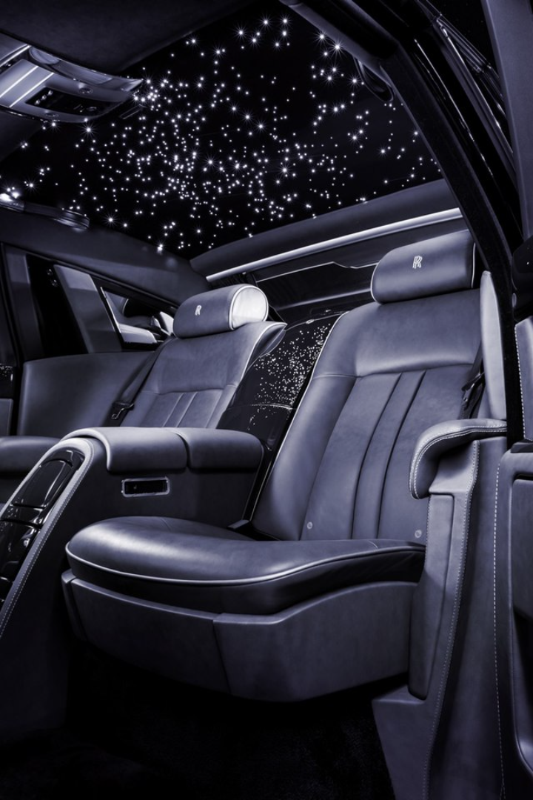

Car Price Prediction
Discover the factors that influence car prices and how to build a model to predict them. Take a deep dive into the exciting world of automotive data science.
by Anil Poddar

Slide 2

Introduction
Welcome to the Car Price Prediction project! In this endeavor, we leverage the power of machine learning to forecast car prices based on a myriad of features. Whether you're a car enthusiast, a data scientist, or someone navigating the automotive market, this project aims to provide valuable insights and predictions.

Slide 3
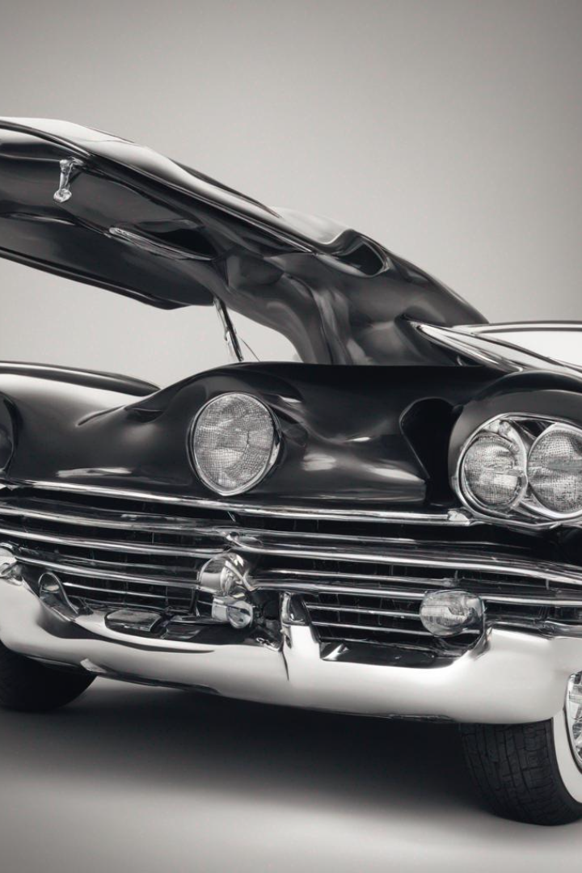
Title:
1: Data Exploration
11: Encoding technique
2: Data cleaning & pre_processing
12: Feature selections and model evaluation
3: Factor influencing car prices
4: Data collection & pre-processing
13: Model selection & training
5: Exploratory data analysis
14: Model evaluation & validation
6: EDA for categorical column
15: Hyper parameter tuning
7: EDA for continuous column
16: Application of the price production model
8: BOX plot
17: Web application
9: Pair Plot
18: Conclusion & Future Work
10: Correlation plot

Slide 4
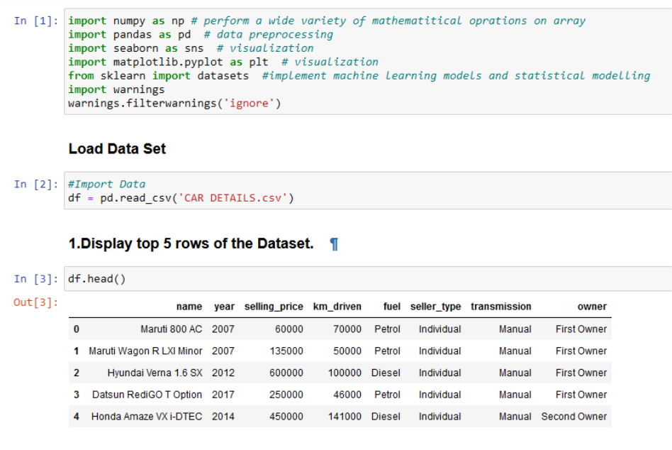
Data Exploration
This data is collected from 'CAR DETAILS'. Following details of cars are included in the dataset: 1) Car name 2) Year 3) Selling Price 4) Kms driven 5) Fuel 6) Seller type 7) Transmission 8) Owner

Slide 5
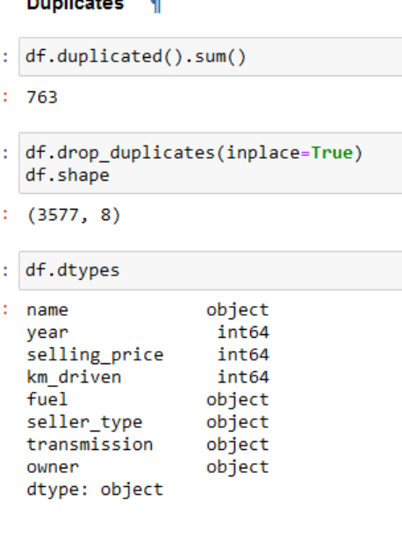
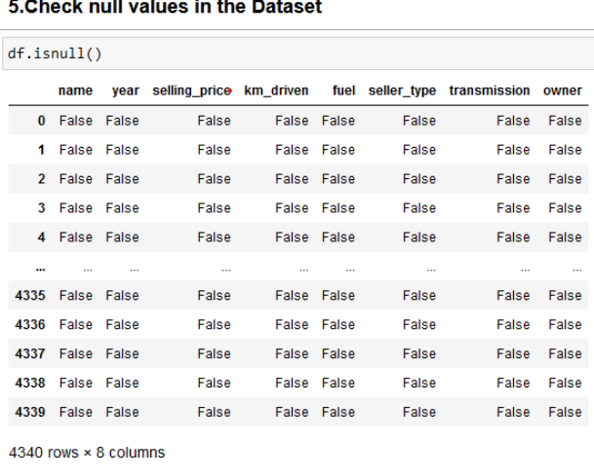
Data Cleaning & Pre-proccessings
Find null values and remove it to clean a data
Checking Duplicates and Drop it

Slide 6
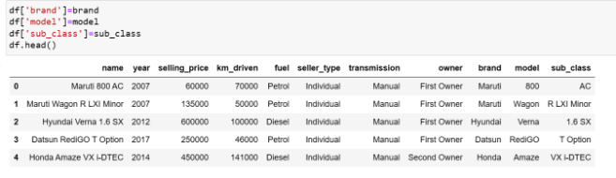
Data Cleaning & Pre-proccessings
car_names=list(df['name'])
brand,model,sub_class=[],[],[]
for car in car_names:
parts=car.split()
Approach
x=parts[0]
We have 1497 unique features in name column
y=parts[1]
z=parts[2:]
To Reduce the complexity in name column we have created three new column such brand, model, sub_class
brand.append(x)
model.append(y)
we can drop the name column
sub_class.append(z)

Slide 7
Factors Influencing Car Prices
1
Brand
2
Year, Make, & Model
The reputation of a car brand and how people perceive it affects the price.
The year, make, and model of a car determine the base price of a car.
3
Mileage
4
Condition
The more mileage on a car, the lower its price will be.
The physical and mechanical condition of a car plays a crucial role in its value.

Slide 8


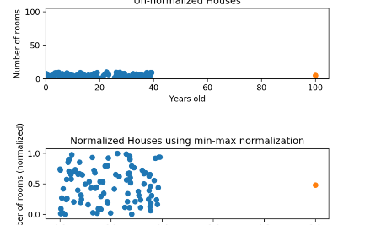
Data Collection and Preprocessing
Data Collection
Data Cleaning
Data Normalization
Exploring various sources to collect structured and unstructured data.
Removing outliers, filling missing values, and transforming data.
Scaling and standardizing data to eliminate bias.

Slide 9
Exploratory Data Analysis
Univariate Analysis
Bivariate Analysis
Study the data distributions
Find correlations between independent and dependent variables
Multivariate Analysis
Data Visualization
Understand the complicated relationships between variables
Present data visually using charts and graphs

Slide 10

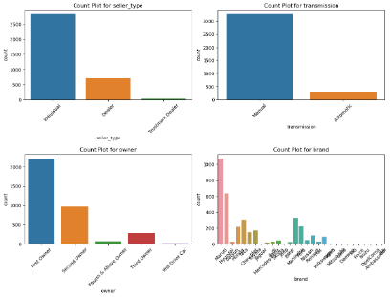
EDA for Categorical Columns
plt.figure(figsize=(12,12))
Insights
for i, cat in enumerate(cat_cols[1:5]):
Most of the used cars available are belongs to petrol and Diesel category
plt.subplot(3,2,i+1)
sns.countplot(data=df,x=cat)
All most all the cars transmisson are of Manually operated
plt.xticks(rotation=45)
plt.title(f'Count Plot for {cat}')
Available cars are more likely to be First and 2nd Hand users only
plt.tight_layout()
#plt.savefig("Categorical Plot")
Sellers prefer to sell their car directly to customers ( individual ) compare to Dealer or Trusted Dealer
plt.show()
Maruti, Hyundai, Mahindra, Tata are most of used cars available in market compare to other brands of cars

Slide 11
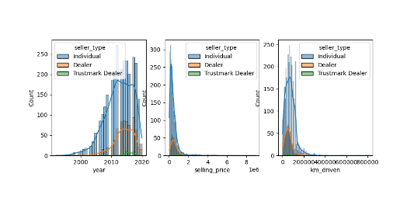
EDA for Continous Columns
Insights
plt.figure(figsize=(10,8))
Loading...
for i in range(len(num_cols)):
Most of the available used cars released after 2005
plt.subplot(2,3,i+1)
90 percentage of cars are sold for less than 1500000
sns.histplot(data=df,x=num_cols[i],kde=True,hue='seller_type')
plt.xticks(rotation=0)
Sellers prefers to sell their cars before reaching 200000 km
plt.savefig('Histoplot ')
plt.tight_layout()
Its clearly indicates individual sellers are more available in the market compare to Third party sellers
plt.show()

Slide 12
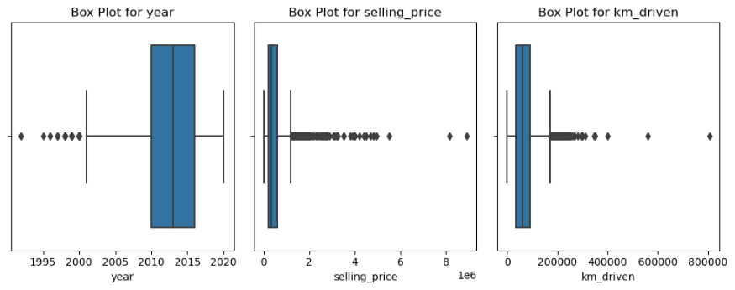
Box Plot
#Treating the selling and Km_driven columns
df['selling_price']=np.where(df["selling_price"]>2675000.0,2675000.0,df['selling_price'])
df['km_driven']=np.where(df['km_driven']>223158.4,223158.4,df['km_driven'])
df['selling_price']=np.where(df["selling_price"]<51786.64,51786.64,df['selling_price'])
df['km_driven']=np.where(df['km_driven']<1744.08,1744.08,df['km_driven'])

Slide 13
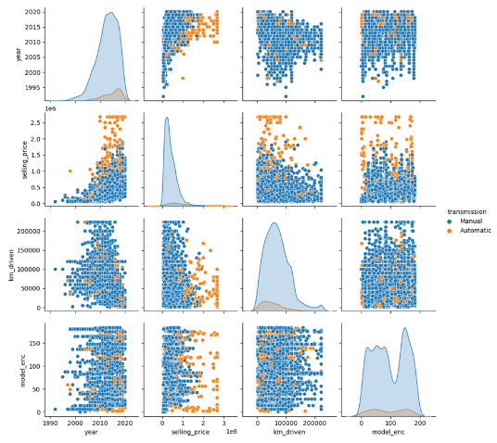
Pair Plot
sns.pairplot(df,hue='transmission')
plt.savefig("Paiplot for continuous variable")
plt.show()
Insights
Plot Selling Price vs Year
Recently released model are costlier than than old models
price of the automatic versions appears to costiler compare to manual transmission
plot year vs Km_driven
There is no partical relationship between model Realeased Year with respect to KM of vehicle
manual and automatic transmission dont seems to some category
Selling price vs KM_driven
Lower the Km driven Higher the cost of vehicle
automatic transmission seems to be costiler compare to manual transmission

Slide 14
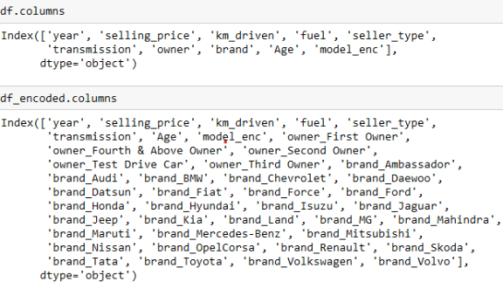
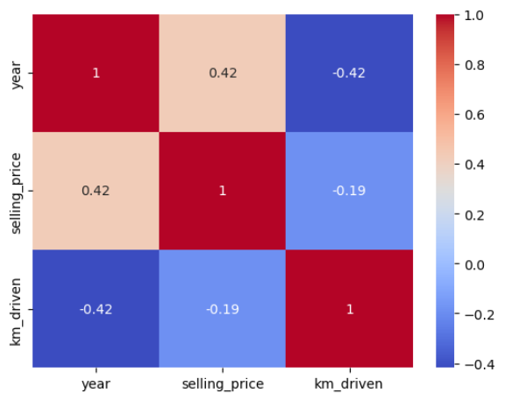
Correlation Plot
One Hot Encoding
df_encoded=pd.get_dummies(df)
df_encoded.head()
corr=df[num_cols].corr()
sns.heatmap(corr,cmap='coolwarm',annot=True)
plt.savefig('Correlation Graph')
plt.show()

Slide 15
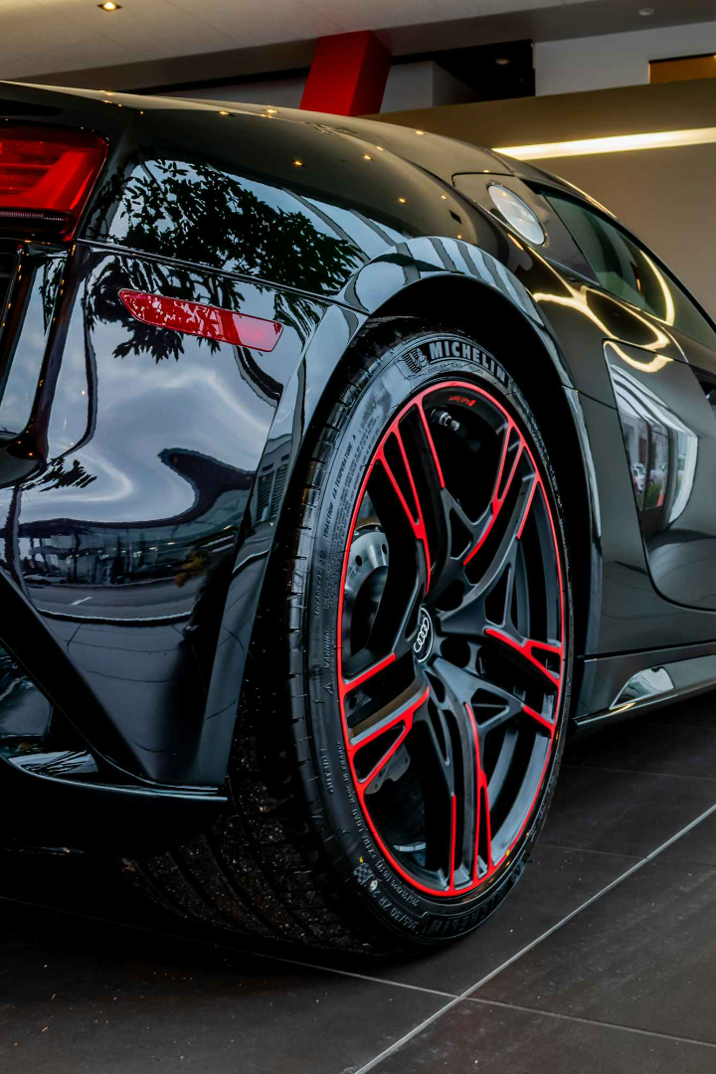
Encoding Technices
Label Encoding
from sklearn.preprocessing import LabelEncoder
lb=LabelEncoder()
df['model_enc']=lb.fit_transform(df['model'])

Slide 16
Feature selections and Model evaluation
Feature Slection
Model Evaluation
x=df_encoded.drop('selling_price',axis=1)
def model_eval(x_train,x_test,y_train,y_test,model,mname):
y=df_encoded['selling_price']
print(x.shape)
model.fit(x_train,y_train)
print(y.shape)
ypred=model.predict(x_test)
mae=mean_absolute_error(y_test,ypred)
mse=mean_squared_error(y_test,ypred)
rmse=np.sqrt(mse)
train_scr=model.score(x_train,y_train)
test_scr=model.score(x_test,y_test)
res=pd.DataFrame({"Train_scr":train_scr,"Test_scr":test_scr,'RMSE':rmse,'MSE':mse,
"MAE":mae},index=[mname])
return res

Slide 17
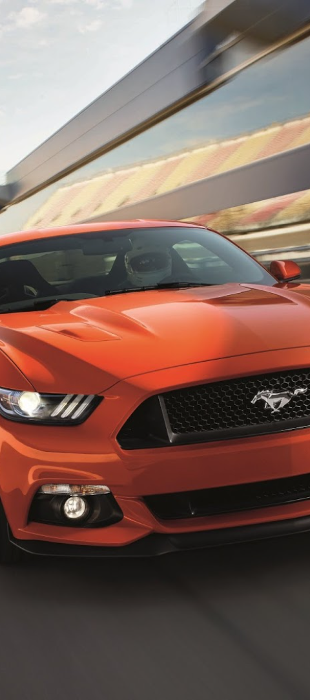
Model Selection and Training
1
Feature Selection
Select the best features that impact the target variable the most
2
Model Selection
Choose a suitable model based on the dataset's characteristics
3
Hyperparameter Tuning
Optimize the model's performance by fine-tuning its parameters

Slide 18
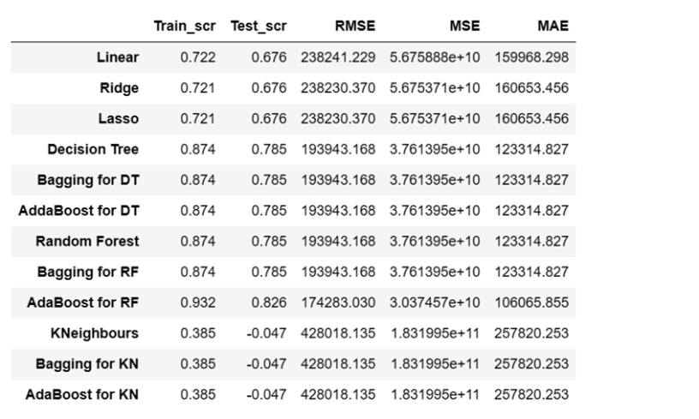
Model Selection and Training
Model Selection.
Choose the appropriate machine learning algorithms, such as Linear Regression, Decision Tree, Random forest, bagging etc.
Model Training
Train the selected models on the preprocessed data, optimizing hyperparameters and evaluating performance.
Insights
All model suffers high over fitting and high error
Tree model appears to more effective compare linear models
KNeighbours appears to be less effective and errors are also high which indicated data is not classified(groups)

Slide 19
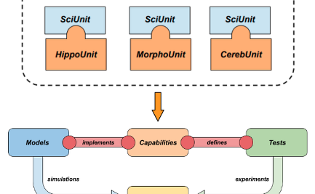
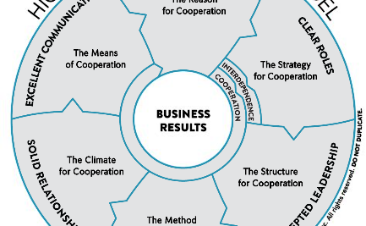
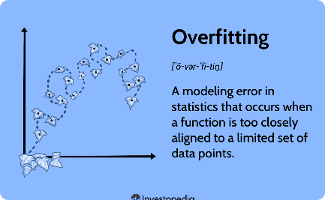
Model Evaluation and Validation
Validation Strategy
Performance Metrics
Overfitting Detection and Correction
Split the dataset into training and testing sets. Check the model's performance on it.
Use metrics like MSE, RMSE, MAE, and R-squared to evaluate the model.
Prevent the model from becoming too complex or fitting the data too closely.

Slide 20
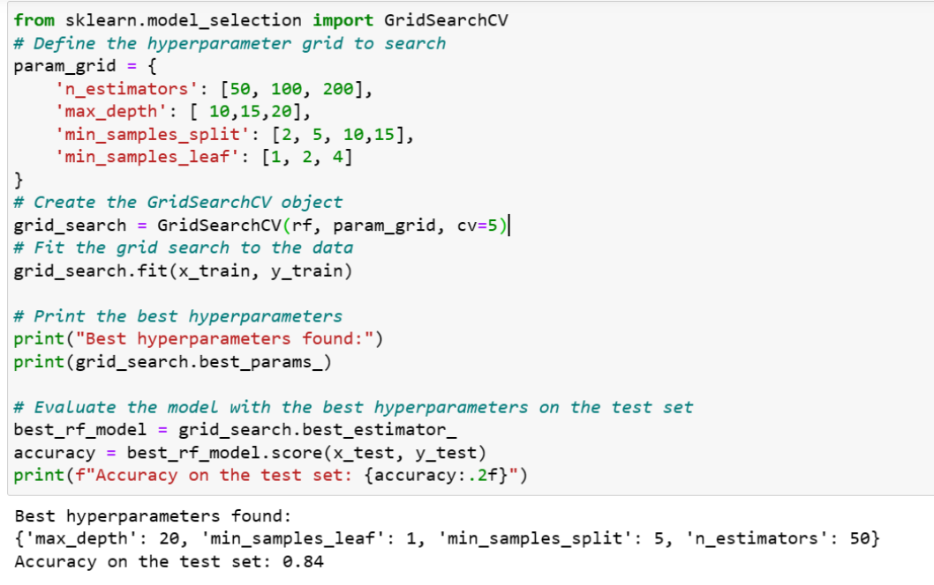
Hyper parameter tuning

Slide 21
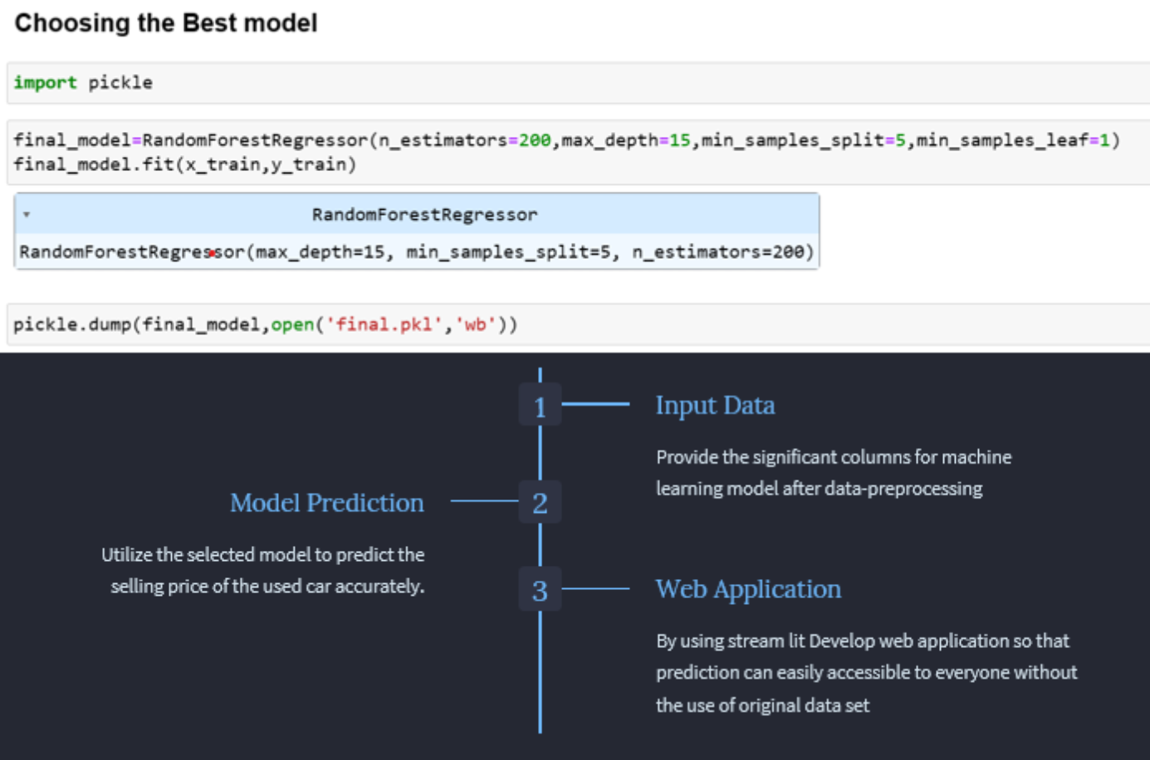

Slide 22
Application of the Price Prediction Model
Real-time Prediction
Consumer Price Awareness
Automation
You can use the model to automate the pricing process if you're in the business of buying and selling cars
With a trained model, you can get an accurate price prediction for any car in seconds
Helps buyers and sellers understand the factors affecting car prices

Slide 23
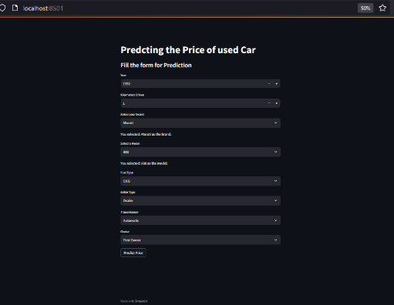
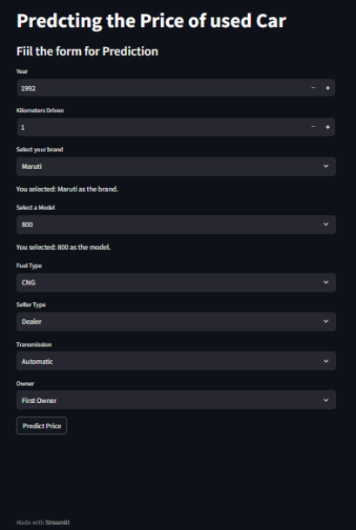
Web Application
Application Before Deployment
It run at local host URL : http://localhost:8501
After Deployment Of Application
LINK URL of web app: https://car-price-prediction-ojsqx4h4pw6ubdubmbzjxr.streamlit.app/

Slide 24
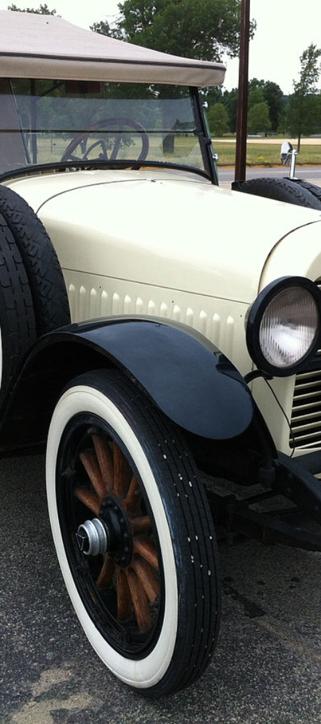
Conclusion and Future Work
1
Conclusion
Building a predictor model for car prices is a powerful tool that has many applications in the automotive industry.
2
Future Work
Apply machine learning techniques like deep learning and neural networks for more accurate predictions or improving the model's performance for better results.

Slide 25

Thank you….
Thank you for joining us today for this presentation. We appreciate your time and attention as we dive into the topic at hand.
In this deck, we will explore various aspects related to car price prediction. We will take you through the journey of understanding the factors influencing car prices, data exploration and cleaning, as well as the application of a price prediction model.
Throughout this presentation, we will provide insights and analysis to help you gain a deeper understanding of the car pricing domain. We hope that the information shared here will be valuable to you and provide a foundation for your own exploration and research.
Once again, thank you for being a part of this presentation. Let's get started!
Prediction Link:https://car-price-prediction-ojsqx4h4pw6ubdubmbzjxr.streamlit.app/

